Slide 1
Physician Drug Adoption Prediction
Prepared by - Aayushi Rai
Dated - 15/03/2021
Email - aayushi.rai.95@gmail.com
Mob - +91- 7982656604
Alt. Mob - +91- 9811563878

Slide 2
Steps Followed for prediction:
1. Extract Features and check below:
a. Features and target should not have any null values
b. Features should be numeric
c. Features should be of the type array/ data frame
d. Features should be having some rows and columns
e. Features should be on the same scale
2. Split the dataset into training and testing datasets
3. Train the model on the training set
4. Test the model on the testing set
5. Predict results for the requested dataset.

Slide 3
Extract Features
For extracting features and data cleaning, we followed below steps:
We found out the null values using below statement in the whole dataset and the column -physician_segment had null values and we replaced the same with the value with the highest count - 'High'.
df.isnull().sum() - this gives the total number of missing values in the dataset for the respective columns.

Slide 4
Checking for Categorical Columns:
Following three columns were categorical in nature:
- physician_gender
- physician_speciality
- physician_segment
Converted the above columns to numerical using pd.get_dummies function.

Slide 5
Normalization
We have normalized the whole dataset except the target variable - brand_prescribed using StandardScaler algorithm in order to bring the data in standard scale and can be used for deriving the data the test results.

Slide 6
Train and Test Split
We have split the data into test and train using train_test_split() method in order to check the accuracy of our model and derive results.

Slide 7
Modelling
Finally comes the part of modelling - KNN
We have used KNN (K Nearest Neighbors ) algorithm to derive results for our dataset.
We have performed the test for different values of n_neighbors to check which value provides the best result.
We have selected n_neighbors = 9 and have predicted the values using the same.

Slide 8
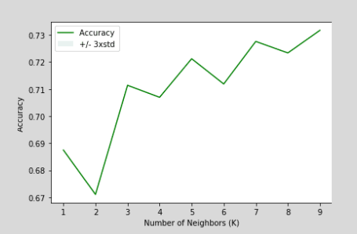

Slide 9
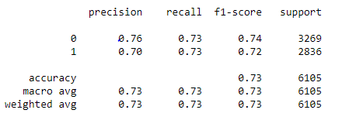
Performance Matrix

Slide 10


